Slide 1
NEO Persistable Classes 1.0 An Efficient Object-Oriented Framework for C#.NEO Smart Contract Development
NEO Community Bluepaper
Michael Herman
https://github.com/mwherman2000/neo-persistibleclasses
neotoronto@outlook.com

Slide 2
Agenda
Purpose
Scenario
Problem
Analysis
Options
Code Solution
Test Results
Future Work
Summary
Appendix A - NEO Blockchain Architecture Reference Model (ARM)

Slide 3
1. Purpose

Slide 4
2. Scenario

Slide 5
3. Problem
public class Point /* Level 0 */
{
private BigInteger _x;
private BigInteger _y;
// Factory methods
private Point()
{
}
}

Slide 6
4. Analysis

Slide 7
5. Options

Slide 8
6. Solution
NPC Level 0 Fields Only
NPC Level 1 Managed
NPC Level 2 Persistable
NPC Level 3 Deletable (Bury/Tombstone)
NPC Level 4 Collectible
NPC Level 5 Extendible (future work)
NPC Level 6 Authorized (future work)

Slide 9
NPC Level 0 Fields Only - Point
public class Point /* Level 0 */
{
private BigInteger _x;
private BigInteger _y;
// Factory methods
private Point()
{
}
}

Slide 10
NPC Level 1 Managed – NeoTrace
public class NeoTrace /* Level *all* */
{
public static void Trace(params object[] args)
{
Neo.SmartContract.Framework.Services.Neo.Runtime.Notify(args);
}
}

Slide 11
NPC Level 1 Managed – NeoEntityModel
public static class NeoEntityModel /* Level 1 */
{
public enum EntityState
{
NULL, INIT, SET
}
public static BigInteger AsBigInteger(this EntityState state)
{
int istate = (int)state;
BigInteger bis = istate;
return bis;
}
public static EntityState BytesToEntityState(byte[] bsta)
{
int ista = (int)bsta.AsBigInteger();
NeoEntityModel.EntityState sta = (NeoEntityModel.EntityState)ista;
return sta;
}
}

Slide 12
NPC Level 1 Managed – Point
public class Point : NeoTrace /* Level 1 */
{
private BigInteger _x;
private BigInteger _y;
private NeoEntityModel.EntityState _state;
// Accessors
public static void SetX(Point p, BigInteger value)
{ p._x = value; p._state = NeoEntityModel.EntityState.SET; }
public static BigInteger GetX(Point p) { return p._x; }
public static void SetY(Point p, BigInteger value)
{ p._y = value; p._state = NeoEntityModel.EntityState.SET; }
public static BigInteger GetY(Point p) { return p._y; }
public static void Set(Point p, BigInteger xvalue, BigInteger yvalue)
{ p._x = xvalue; p._y = yvalue; p._state = NeoEntityModel.EntityState.SET; }

Slide 13
NPC Level 1 Managed – Point (con’t)
// Factory methods
private Point()
{
}
private static Point _Initialize(Point p)
{
p._x = 0;
p._y = 0;
p._state = NeoEntityModel.EntityState.NULL; ;
LogExt("_Initialize(p).p", p);
return p;
}
public static Point New()
{
Point p = new Point();
_Initialize(p);
LogExt("New().p", p);
return p;
}

Slide 14
NPC Level 1 Managed – Point (con’t)
public static Point New(int x, int y)
{
Point p = new Point();
p._x = x;
p._y = y;
p._state = NeoEntityModel.EntityState.INIT;
LogExt("New(x,y).p", p);
return p;
}
public static Point Null()
{
Point p = new Point();
_Initialize(p);
LogExt("Null().p", p);
return p;
}

Slide 15
NPC Level 1 Managed – Point (con’t)
// EntityState wrapper methods
public static bool IsNull(Point p)
{
return (p._state == NeoEntityModel.EntityState.NULL);
}
// Log/trace methods
public static void Log(string label, Point p)
{
NeoTrace.Trace(label, p._x, p._y);
}
public static void LogExt(string label, Point p)
{
NeoTrace.Trace(label, p._x, p._y, p._state);
}
}

Slide 16
NPC Level 2 Persistable - NeoEntityModel
public static class NeoEntityModel /* Level 2 Persistible */
{
public enum EntityState
{
NULL, INIT, SET, PUTTED, GETTED, MISSING
}
public static BigInteger AsBigInteger(this EntityState state)
{
int istate = (int)state;
BigInteger bis = istate;
return bis;
}
public static EntityState BytesToEntityState(byte[] bsta)
{
int ista = (int)bsta.AsBigInteger();
NeoEntityModel.EntityState sta = (NeoEntityModel.EntityState)ista;
return sta;
}
}

Slide 17
NPC Level 2 Persistable – Point
public class Point : NeoTrace /* Level 2 Persistible */
{
private BigInteger _x;
private BigInteger _y;
private NeoEntityModel.EntityState _state;
// Accessors
public static void SetX(Point p, BigInteger value)
{ p._x = value; p._state = NeoEntityModel.EntityState.SET; }
public static BigInteger GetX(Point p) { return p._x; }
public static void SetY(Point p, BigInteger value)
{ p._y = value; p._state = NeoEntityModel.EntityState.SET; }
public static BigInteger GetY(Point p) { return p._y; }
public static void Set(Point p, BigInteger xvalue, BigInteger yvalue)
{ p._x = xvalue; p._y = yvalue; p._state = NeoEntityModel.EntityState.SET; }

Slide 18
NPC Level 2 Persistable – Point (con’t)
// Class name and property names
private const string _className = "Point";
private const string _sX = "X";
private const string _sY = "Y";
private const string _sSTA = "_STA";
private const string _sEXT = "_EXT";
private static readonly byte[] _bX = Helper.AsByteArray(_sX);
private static readonly byte[] _bY = Helper.AsByteArray(_sY);
private static readonly byte[] _bSTA = Helper.AsByteArray(_sSTA);
private static readonly byte[] _bEXT = Helper.AsByteArray(_sEXT);
// Internal fields
private const string _classKeyTag = "/#" + _className + ".";
private static readonly byte[] _bclassKeyTag = Helper.AsByteArray(_classKeyTag);

Slide 19
NPC Level 2 Persistable – Point (con’t)
// Factory methods
private Point()
{
}
private static Point _Initialize(Point p)
{
p._x = 0; p._y = 0;
p._state = NeoEntityModel.EntityState.NULL; ;
LogExt("_Initialize(p).p", p);
return p;
}
public static Point New()
{
Point p = new Point();
_Initialize(p);
LogExt("New().p", p);
return p;
}

Slide 20
NPC Level 2 Persistable – Point (con’t)
public static Point New(int x, int y)
{
Point p = new Point();
p._x = x; p._y = y;
p._state = NeoEntityModel.EntityState.INIT;
LogExt("New(x,y).p", p);
return p;
}
public static Point Null()
{
Point p = new Point();
_Initialize(p);
LogExt("Null().p", p);
return p;
}

Slide 21
NPC Level 2 Persistable – Point (con’t)
// EntityState wrapper methods
public static bool IsNull(Point p)
{
return (p._state == NeoEntityModel.EntityState.NULL);
}
// Log/trace methods
public static void Log(string label, Point p)
{
NeoTrace.Trace(label, p._x, p._y);
}
public static void LogExt(string label, Point p)
{
NeoTrace.Trace(label, p._x, p._y, p._state);
}

Slide 22
NPC Level 2 Persistable – Point (con’t)
// Persistable methods
public static bool IsMissing(Point p)
{
return (p._state == NeoEntityModel.EntityState.MISSING);
}
public static Point Missing()
{
Point p = new Point();
p._x = 0; p._y = 0;
p._state = NeoEntityModel.EntityState.MISSING;
LogExt("Missing().p", p);
return p;
}

Slide 23
NPC Level 2 Persistable – Point (con’t)
public static bool Put(Point p, byte[] key)
{
if (key.Length == 0) return false;
Neo.SmartContract.Framework.Services.Neo.StorageContext ctx =
Neo.SmartContract.Framework.Services.Neo.Storage.CurrentContext;
byte[] _bkeyTag = Helper.Concat(key, _bclassKeyTag);
p._state = NeoEntityModel.EntityState.PUTTED;
Neo.SmartContract.Framework.Services.Neo.Storage.Put(ctx,
Helper.Concat(_bkeyTag, _bSTA), p._state.AsBigInteger());
Neo.SmartContract.Framework.Services.Neo.Storage.Put(ctx,
Helper.Concat(_bkeyTag, _bX), p._x);
Neo.SmartContract.Framework.Services.Neo.Storage.Put(ctx,
Helper.Concat(_bkeyTag, _bY), p._y);
LogExt("Put(bkey).p", p);
return true;
}

Slide 24
NPC Level 2 Persistable – Point (con’t)
public static Point Get(byte[] key)
{
if (key.Length == 0) return Null();
Neo.SmartContract.Framework.Services.Neo.StorageContext ctx =
Neo.SmartContract.Framework.Services.Neo.Storage.CurrentContext;
byte[] _bkeyTag = Helper.Concat(key, _bclassKeyTag);
Point p;
byte[] bsta = Neo.SmartContract.Framework.Services.Neo.Storage.Get(ctx, Helper.Concat(_bkeyTag, _bSTA));
NeoTrace.Trace("Get(kb).bs", bsta.Length, bsta);
if (bsta.Length == 0)
{
p = Point.Missing();
}
else // not MISSING
{
byte[] bext = Neo.SmartContract.Framework.Services.Neo.Storage.Get(ctx, Helper.Concat(_bkeyTag, _bEXT));
int ista = (int)bsta.AsBigInteger();
NeoEntityModel.EntityState sta = (NeoEntityModel.EntityState)ista;
p = new Point();
BigInteger x = Neo.SmartContract.Framework.Services.Neo.Storage.Get(ctx,
Helper.Concat(_bkeyTag, _bX)).AsBigInteger();
BigInteger y = Neo.SmartContract.Framework.Services.Neo.Storage.Get(ctx,
Helper.Concat(_bkeyTag, _bY)).AsBigInteger();
p._x = x; p._y = y; p._state = sta;
p._state = NeoEntityModel.EntityState.GETTED; /* OVERRIDE */
}
LogExt("Get(kb).p", p);
return p;
}

Slide 25
NPC Level 2 Persistable – Point (con’t)
public static Point Get(byte[] key)
{
if (key.Length == 0) return Null();
Neo.SmartContract.Framework.Services.Neo.StorageContext ctx =
Neo.SmartContract.Framework.Services.Neo.Storage.CurrentContext;
byte[] _bkeyTag = Helper.Concat(key, _bclassKeyTag);
Point p;
byte[] bsta = Neo.SmartContract.Framework.Services.Neo.Storage.Get(ctx, Helper.Concat(_bkeyTag, _bSTA));
NeoTrace.Trace("Get(kb).bs", bsta.Length, bsta);
if (bsta.Length == 0)
{
p = Point.Missing();
}
else // not MISSING
{
byte[] bext = Neo.SmartContract.Framework.Services.Neo.Storage.Get(ctx, Helper.Concat(_bkeyTag, _bEXT));
int ista = (int)bsta.AsBigInteger();
NeoEntityModel.EntityState sta = (NeoEntityModel.EntityState)ista;
p = new Point();
BigInteger x = Neo.SmartContract.Framework.Services.Neo.Storage.Get(ctx,
Helper.Concat(_bkeyTag, _bX)).AsBigInteger();
BigInteger y = Neo.SmartContract.Framework.Services.Neo.Storage.Get(ctx,
Helper.Concat(_bkeyTag, _bY)).AsBigInteger();
p._x = x; p._y = y; p._state = sta;
p._state = NeoEntityModel.EntityState.GETTED; /* OVERRIDE */
}
LogExt("Get(kb).p", p);
return p;
}

Slide 26
NPC Level 3 Deletable - NeoEntityModel
public static class NeoEntityModel /* Level 3 Deletable */
{
public enum EntityState
{
NULL, INIT, SET, PUTTED, GETTED, MISSING, TOMBSTONED
}
public static BigInteger AsBigInteger(this EntityState state)
{
int istate = (int)state;
BigInteger bis = istate;
return bis;
}
public static EntityState BytesToEntityState(byte[] bsta)
{
int ista = (int)bsta.AsBigInteger();
NeoEntityModel.EntityState sta = (NeoEntityModel.EntityState)ista;
return sta;
}
}

Slide 27
NPC Level 3 Deletable - Point
...
// Persistable methods
public static bool IsMissing(Point p)
{
return (p._state == NeoEntityModel.EntityState.MISSING);
}
public static Point Missing()
{
Point p = new Point();
p._x = 0;
p._y = 0;
p._state = NeoEntityModel.EntityState.MISSING;
LogExt("Missing().p", p);
return p;
}
...

Slide 28
NPC Level 3 Deletable – Point (con’t)
...
// Deletable methods
public static bool IsBuried(Point p)
{
return (p._state == NeoEntityModel.EntityState.TOMBSTONED);
}
public static Point Tombstone()
{
Point p = new Point();
p._x = 0;
p._y = 0;
p._state = NeoEntityModel.EntityState.TOMBSTONED;
LogExt("Tombstone().p", p);
return p;
}
...

Slide 29
NPC Level 3 Deletable – Point (con’t)
...
public static Point Bury(byte[] key)
{
if (key.Length == 0) return Null();
Neo.SmartContract.Framework.Services.Neo.StorageContext ctx =
Neo.SmartContract.Framework.Services.Neo.Storage.CurrentContext;
byte[] _bkeyTag = Helper.Concat(key, _bclassKeyTag);
Point p;
byte[] bsta = Neo.SmartContract.Framework.Services.Neo.Storage.Get(ctx, Helper.Concat(_bkeyTag, _bSTA));
NeoTrace.Trace("Bury(kb).bs", bsta.Length, bsta);
if (bsta.Length == 0)
{
p = Point.Missing();
}
else // not MISSING - bury it
{
p = Point.Tombstone();
Neo.SmartContract.Framework.Services.Neo.Storage.Put(ctx,
Helper.Concat(_bkeyTag, _bSTA), p._state.AsBigInteger());
Neo.SmartContract.Framework.Services.Neo.Storage.Put(ctx, Helper.Concat(_bkeyTag, _bX), p._x);
Neo.SmartContract.Framework.Services.Neo.Storage.Put(ctx, Helper.Concat(_bkeyTag, _bY), p._y);
}
LogExt("Bury(kb).p", p);
return p; // return Point p to signal if key is Missing or bad key
}
...

Slide 30
NPC Level 4 Collectible - NeoEntityModel
public static class NeoEntityModel /* Level 4 Collectible */
{
public enum EntityState
{
NULL, INIT, SET, PUTTED, GETTED, MISSING, TOMBSTONED, NOTAUTHORIZED /* Future */
}
public static BigInteger AsBigInteger(this EntityState state)
{
int istate = (int)state;
BigInteger bis = istate;
return bis;
}
public static EntityState BytesToEntityState(byte[] bsta)
{
int ista = (int)bsta.AsBigInteger();
NeoEntityModel.EntityState sta = (NeoEntityModel.EntityState)ista;
return sta;
}
public static readonly byte[] NullScriptHash = "".ToScriptHash();
public static readonly byte[] NullByteArray = "".AsByteArray();
}

Slide 31
NPC Level 4 Collectible - NeoVersionedAppUser
public class NeoVersionedAppUser
{
private byte[] _app;
private int _major;
private int _minor;
private int _build;
private byte[] _userScriptHash;
private NeoEntityModel.EntityState _state;

Slide 32
NPC Level 4 Collectible – NeoVersionedAppUser
public static void SetAppName(NeoVersionedAppUser vau, byte[] value)
{ vau._app = value; vau._state = NeoEntityModel.EntityState.SET; }
public static byte[] GetAppNameAsByteArray(NeoVersionedAppUser vau) { return vau._app; }
public static void SetAppName(NeoVersionedAppUser vau, string value)
{ vau._app = value.AsByteArray(); vau._state = NeoEntityModel.EntityState.SET; }
public static string GetAppNameAsString(NeoVersionedAppUser vau) { return vau._app.AsString(); }
public static void SetMajor(NeoVersionedAppUser vau, int value)
{ vau._major = value; vau._state = NeoEntityModel.EntityState.SET; }
public static int GetMajor(NeoVersionedAppUser vau) { return vau._major; }
public static void SetMinor(NeoVersionedAppUser vau, int value)
{ vau._minor = value; vau._state = NeoEntityModel.EntityState.SET; }
public static int GetMinor(NeoVersionedAppUser vau) { return vau._minor; }
public static void SetBuild(NeoVersionedAppUser vau, int value)
{ vau._build = value; vau._state = NeoEntityModel.EntityState.SET; }
public static int GetBuild(NeoVersionedAppUser vau) { return vau._build; }
public static void SetUserScriptHash(NeoVersionedAppUser vau, byte[] value)
{ vau._userScriptHash = value; vau._state = NeoEntityModel.EntityState.SET; }
public static byte[] GetUserScriptHash(NeoVersionedAppUser vau) { return vau._userScriptHash; }
public static void Set(NeoVersionedAppUser vau, byte[] app, int major, int minor, int build, byte[] userScriptHash)
{
vau._app = app; vau._major = major; vau._minor = minor; vau._build = build;
vau._userScriptHash = userScriptHash; vau._state = NeoEntityModel.EntityState.SET;
}
public static void Set(NeoVersionedAppUser vau, string app, int major, int minor, int build, byte[] userScriptHash)
{
vau._app = app.AsByteArray(); vau._major = major; vau._minor = minor; vau._build = build;
vau._userScriptHash = userScriptHash; vau._state = NeoEntityModel.EntityState.SET;
}

Slide 33
NPC Level 4 Collectible - NeoStorageKey
public class NeoStorageKey
{
private byte[] _app;
private int _major;
private int _minor;
private int _build;
private byte[] _userScriptHash;
private byte[] _className;
private int _index;
private string _fieldName;
private NeoEntityModel.EntityState _state;

Slide 34
NPC Level 4 Collectible – NeoStorageKey (con’t)
public static NeoStorageKey New(NeoVersionedAppUser vau, byte[] className)
{
if (NeoVersionedAppUser.IsNull(vau))
{
return NeoStorageKey.Null();
}
NeoStorageKey nsk = new NeoStorageKey();
nsk._app = NeoVersionedAppUser.GetAppNameAsByteArray(vau);
nsk._major = NeoVersionedAppUser.GetMajor(vau);
nsk._minor = NeoVersionedAppUser.GetMinor(vau);
nsk._build = NeoVersionedAppUser.GetBuild(vau);
nsk._userScriptHash = NeoVersionedAppUser.GetUserScriptHash(vau);
nsk._className = className;
nsk._index = 0;
nsk._fieldName = "";
nsk._state = NeoEntityModel.EntityState.INIT;
LogExt("New(vau,bc)", nsk);
return nsk;
}

Slide 35
NPC Level 4 Collectible – NeoStorageKey (con’t)
private static readonly byte[] _bLeftBrace = "{".AsByteArray();
private static readonly byte[] _bRightBrace = "}".AsByteArray();
private static readonly byte[] _bColon = ":".AsByteArray();
private static readonly byte[] _bEquals = "=".AsByteArray();
private static readonly byte[] _bSemiColon = ";".AsByteArray();
private static readonly byte[] _ba = "a".AsByteArray(); // App name
private static readonly byte[] _bM = "M".AsByteArray(); // App major version
private static readonly byte[] _bm = "m".AsByteArray(); // App minor version
private static readonly byte[] _bb = "b".AsByteArray(); // App build number
private static readonly byte[] _bu = "u".AsByteArray(); // User script hash
private static readonly byte[] _bc = "c".AsByteArray(); // Class name
private static readonly byte[] _bi = "i".AsByteArray(); // Index value
private static readonly byte[] _bf = "f".AsByteArray(); // Field name
private static readonly byte[] _bStringType =
{ (byte)Neo.SmartContract.ContractParameterType.String };
private static readonly byte[] _bBigIntegerType =
{ (byte)Neo.SmartContract.ContractParameterType.Integer };
private static readonly byte[] _bUserScriptHashType =
{ (byte)Neo.SmartContract.ContractParameterType.ByteArray };

Slide 36
NPC Level 4 Collectible – NeoStorageKey (con’t)
public static byte[] StorageKey(NeoStorageKey nsk, int index, byte[] fieldName)
{
LogExt("StorageKey(nsk,i,fb).nsk", nsk);
byte[] bkey = Helper.Concat(_bLeftBrace, _ba).Concat(_bColon).Concat(_bStringType)
.Concat(_bEquals).Concat(nsk._app).Concat(_bSemiColon);
bkey = Helper.Concat(bkey, _bM).Concat(_bColon).Concat(_bBigIntegerType) .Concat(_bEquals).Concat(((BigInteger)(nsk._major)).AsByteArray()).Concat(_bSemiColon);
bkey = Helper.Concat(bkey, _bm).Concat(_bColon).Concat(_bBigIntegerType)
.Concat(_bEquals).Concat(((BigInteger)(nsk._minor)).AsByteArray()).Concat(_bSemiColon);
bkey = Helper.Concat(bkey, _bb).Concat(_bColon).Concat(_bBigIntegerType)
.Concat(_bEquals).Concat(((BigInteger)(nsk._build)).AsByteArray()).Concat(_bSemiColon);
bkey = Helper.Concat(bkey, _bu).Concat(_bColon).Concat(_bUserScriptHashType)
.Concat(_bEquals).Concat(nsk._userScriptHash).Concat(_bSemiColon);
bkey = Helper.Concat(bkey, _bc).Concat(_bColon).Concat(_bStringType)
.Concat(_bEquals).Concat(nsk._className).Concat(_bSemiColon);
bkey = Helper.Concat(bkey, _bi).Concat(_bColon).Concat(_bBigIntegerType)
.Concat(_bEquals).Concat(((BigInteger)(index)).AsByteArray()).Concat(_bSemiColon);
bkey = Helper.Concat(bkey, _bf).Concat(_bColon).Concat(_bStringType)
.Concat(_bEquals).Concat(fieldName).Concat(_bSemiColon);
bkey = Helper.Concat(bkey, _bRightBrace);
NeoTrace.Trace("StorageKey(nsk).bkey$BSK", bkey);
return bkey;
}

Slide 37
NPC Level 4 Collectible - Point
public static Point BuryElement(NeoVersionedAppUser vau, int index)
{
if (NeoVersionedAppUser.IsNull(vau)) return Point.Null();
Neo.SmartContract.Framework.Services.Neo.StorageContext ctx =
Neo.SmartContract.Framework.Services.Neo.Storage.CurrentContext;
NeoStorageKey nsk = NeoStorageKey.New(vau, "Point");
byte[] bkey;
Point p;
byte[] bsta = Neo.SmartContract.Framework.Services.Neo.Storage.Get(ctx, NeoStorageKey.StorageKey(nsk, index, _bSTA));
NeoTrace.Trace("Bury(vau,index).bs", bsta.Length, bsta);
if (bsta.Length == 0)
{
p = Point.Missing();
}
else // not MISSING - bury it
{
p = Point.Tombstone();
Neo.SmartContract.Framework.Services.Neo.Storage.Put(ctx, NeoStorageKey.StorageKey(nsk, index, _bSTA),
p._state.AsBigInteger());
Neo.SmartContract.Framework.Services.Neo.Storage.Put(ctx, NeoStorageKey.StorageKey(nsk, index, _bEXT),
p._extension);
Neo.SmartContract.Framework.Services.Neo.Storage.Put(ctx, NeoStorageKey.StorageKey(nsk, index, _bX), p._x);
Neo.SmartContract.Framework.Services.Neo.Storage.Put(ctx, NeoStorageKey.StorageKey(nsk, index, _bY), p._y);
}
LogExt("Bury(vau,i).p", p);
return p;
}

Slide 38
7. Test Results
Test1()
Dump miscellaneous variables to the log
Test2()
NPC Level 1 test cases: Create 3 Points and a line. Add two Points. Log the results.
Test3()
NPC Level 2/3 test cases: Create 3 Points and test NPC Level 3 entity persistence. Log the results.
Test4()
NPC Level 2/3 test cases: Test IsNull(), IsMissing() and IsExtended(). Log the results.
Test5()
NPC Level 4 test cases: Test NeoStorageKeys. Log the results.
Test6()
NPC Level 4 test cases: Test NeoStorageKeys. Log the results

Slide 39
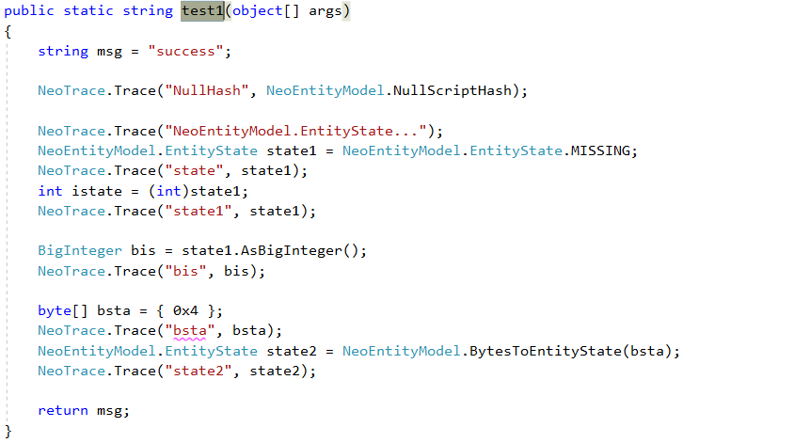
Test1() – Code

Slide 40
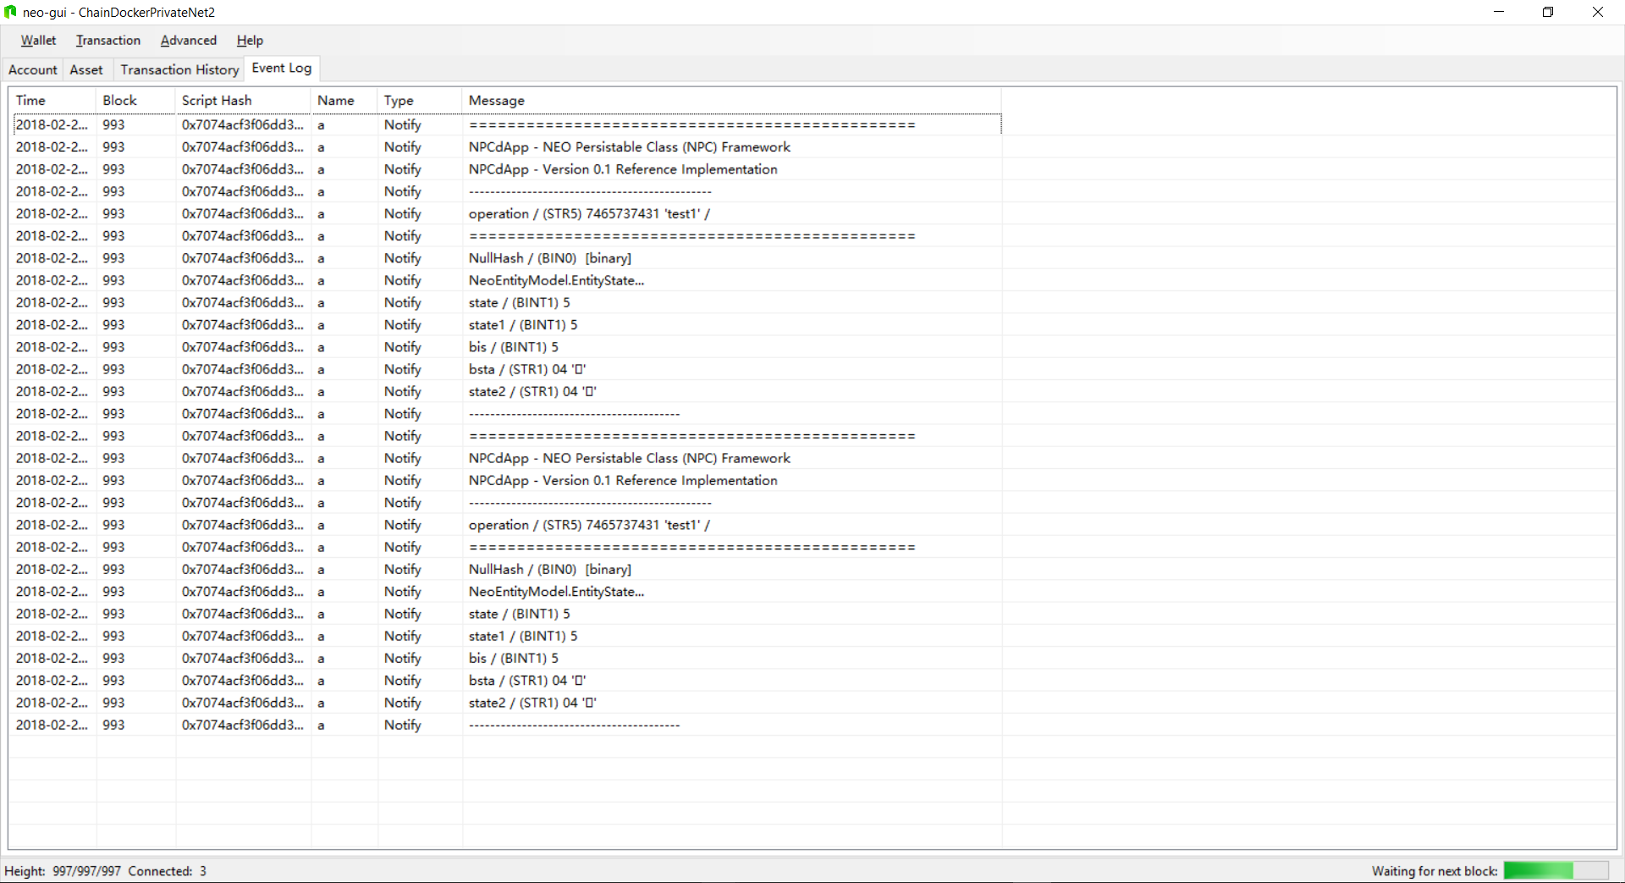
Test1() – neo-gui Event Log

Slide 41
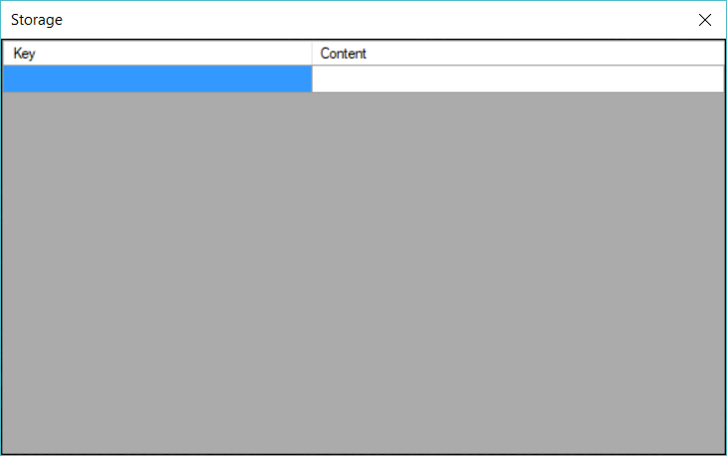
Test1() – neo-debugger Storage Viewer

Slide 42
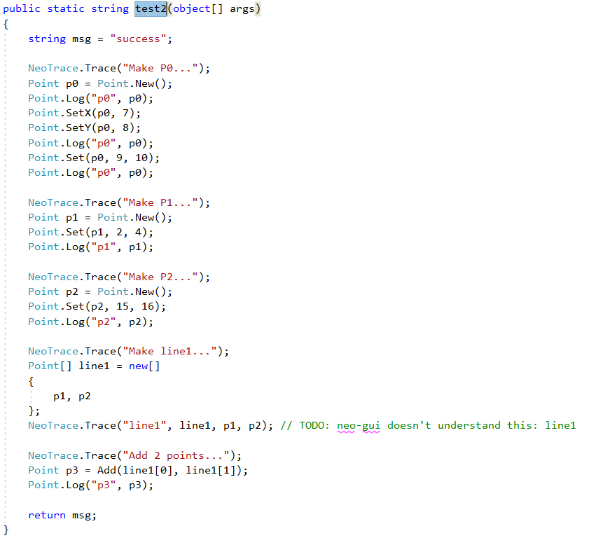
Test2() – Code

Slide 43
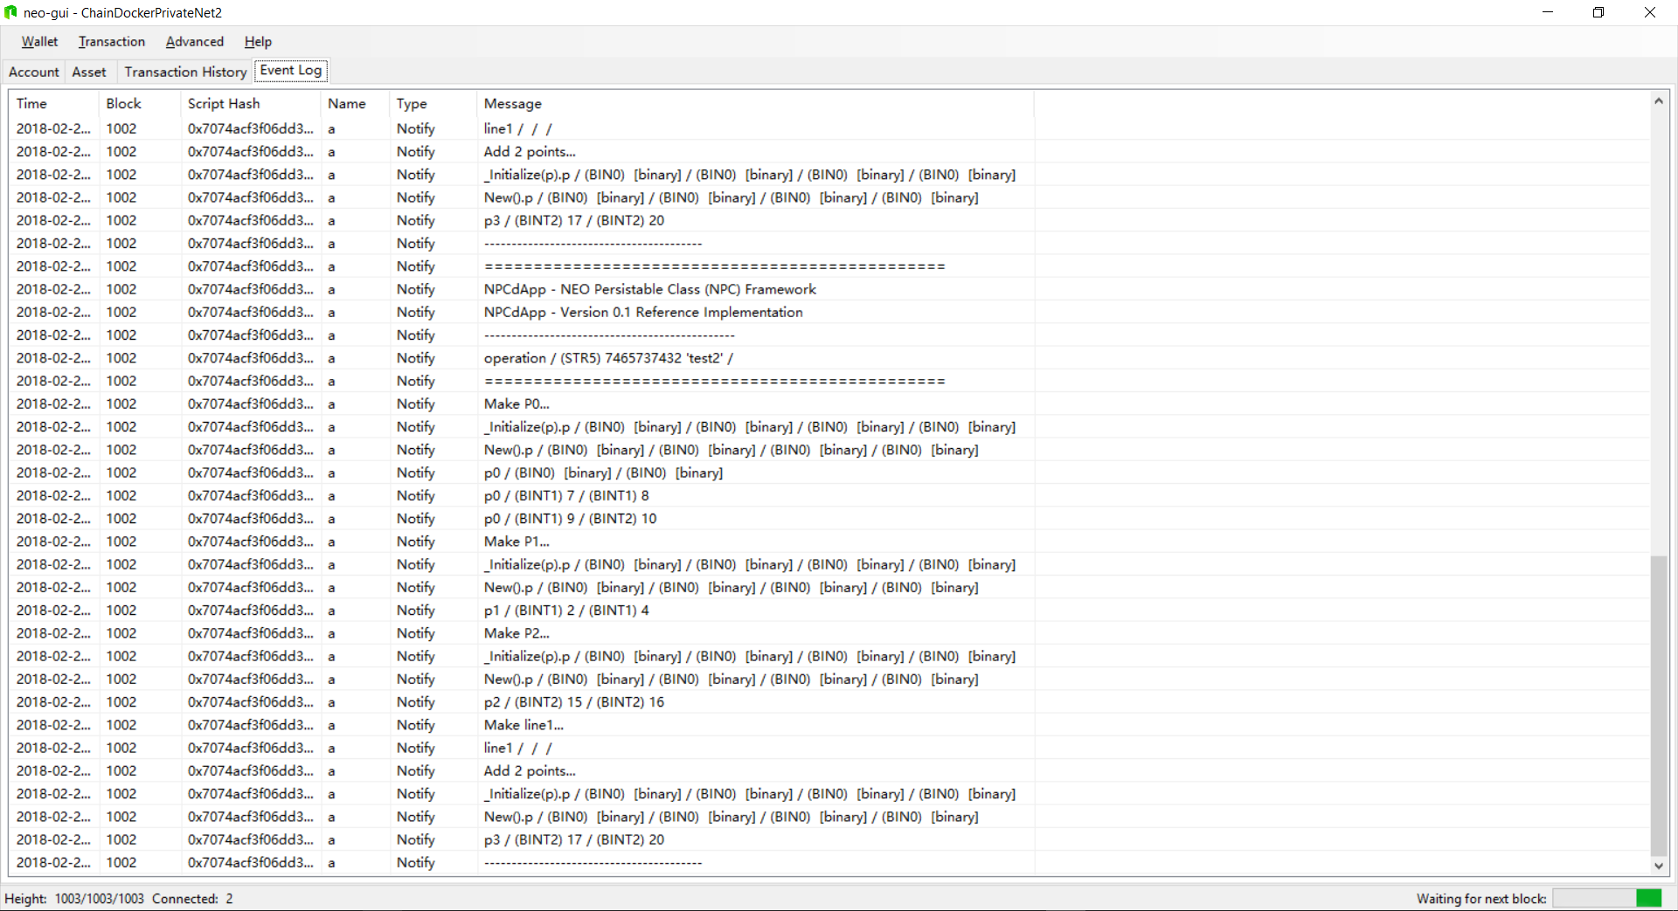
Test2() – neo-gui Event Log

Slide 44
Test2() – neo-debugger Storage Viewer

Slide 45
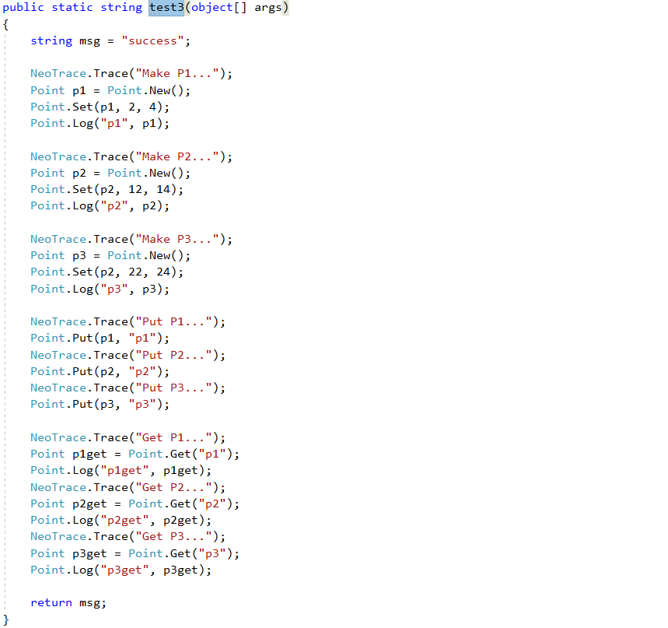
Test3() – Code

Slide 46
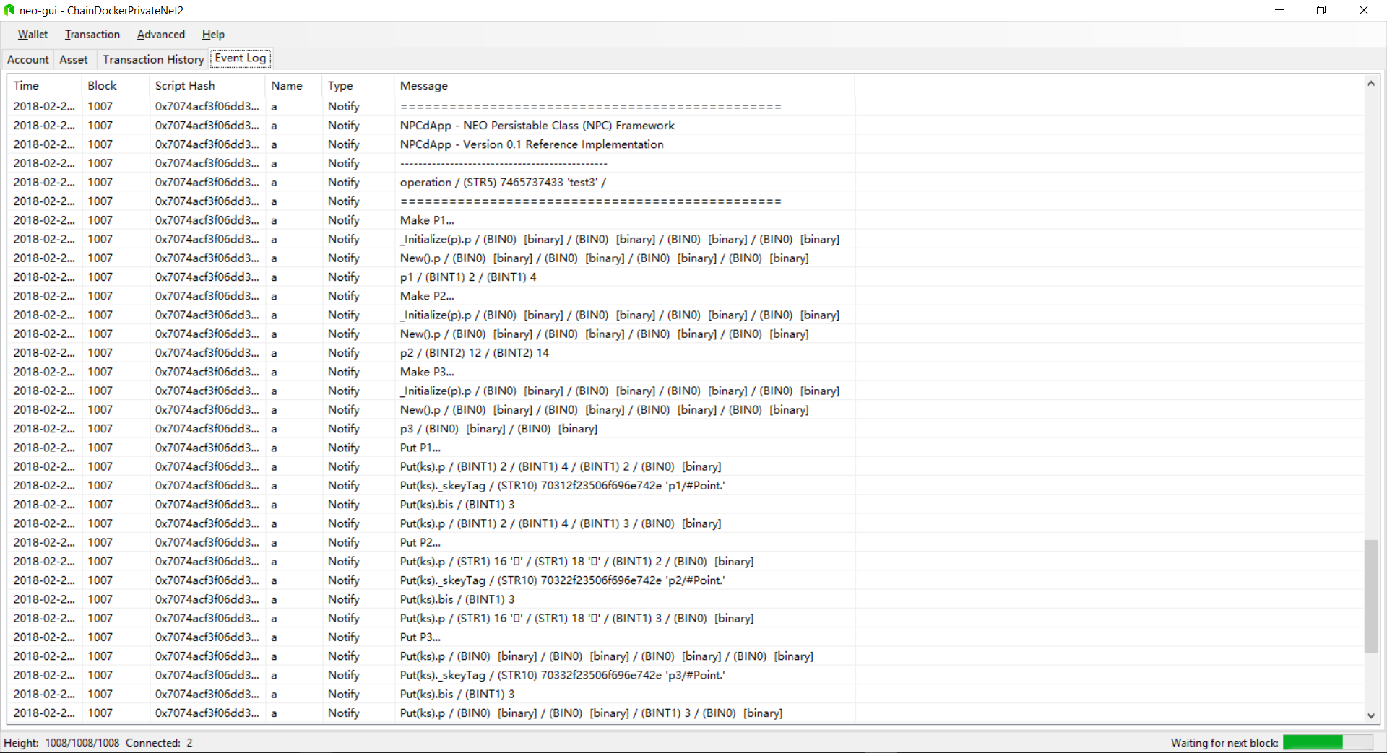
Test3() – neo-gui Event Log

Slide 47
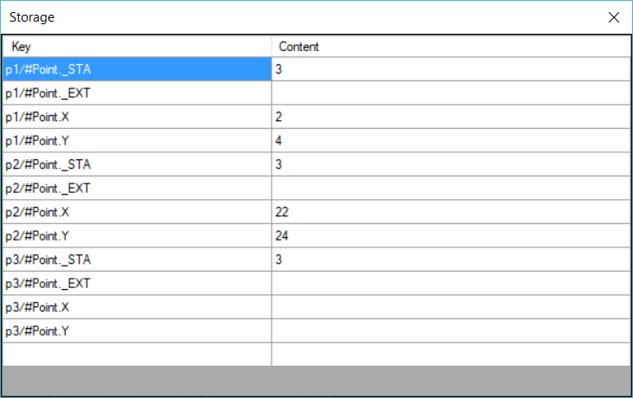
Test3() – neo-debugger Storage Viewer

Slide 48
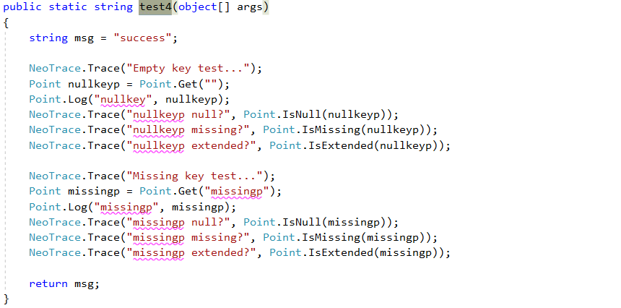
Test4() – Code

Slide 49
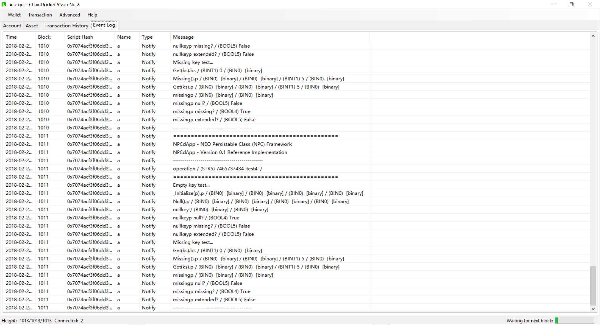
Test4() – neo-gui Event Log

Slide 50
Test4() – neo-debugger Storage Viewer

Slide 51
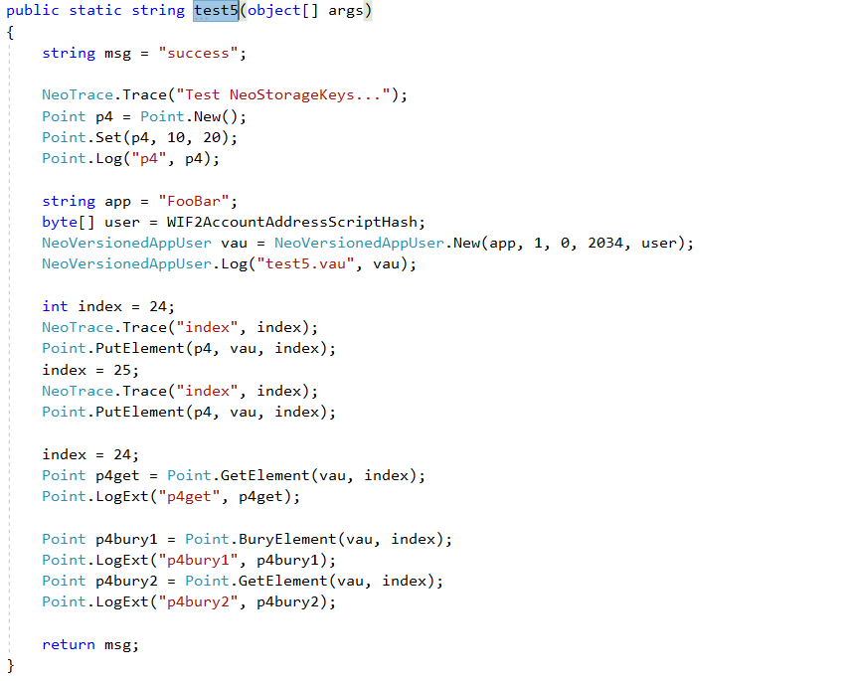
Test5() – Code

Slide 52
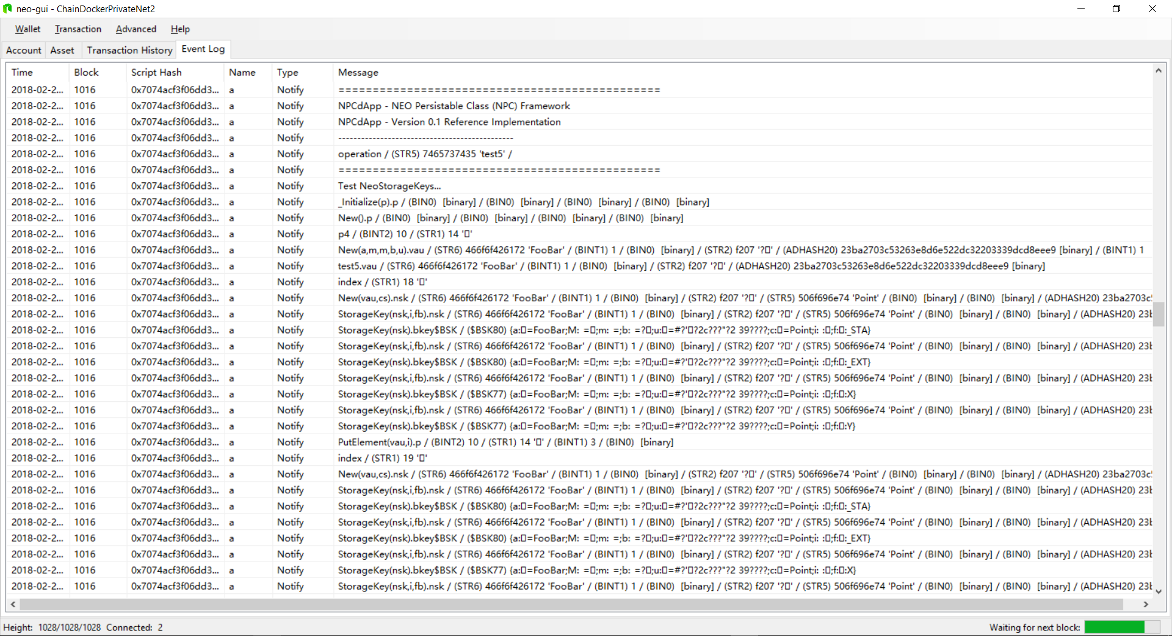
Test5() – neo-gui Event Log

Slide 53
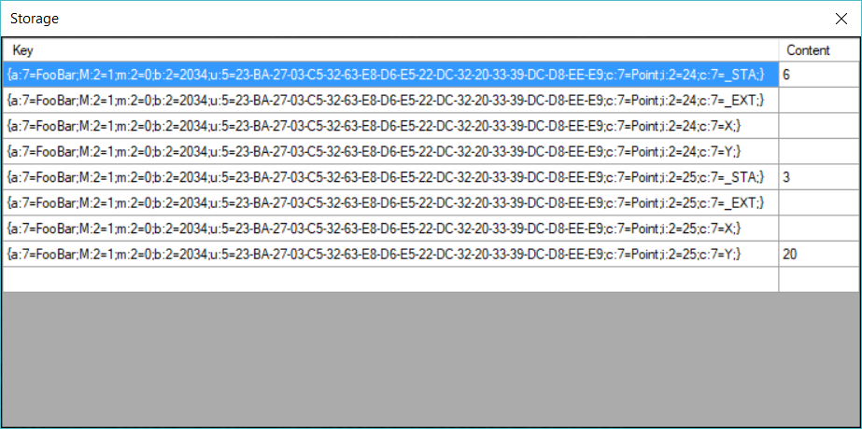
Test5() – neo-debugger Storage Viewer

Slide 54
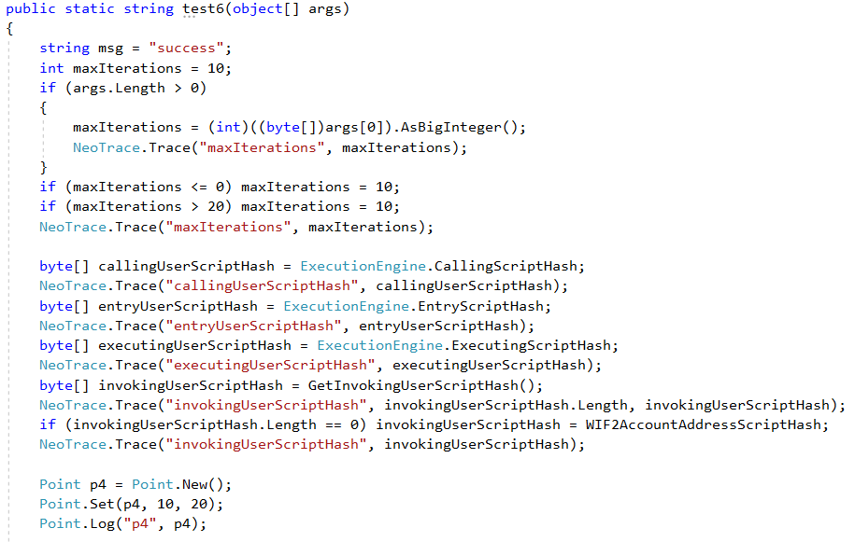
Test6() – Code

Slide 55
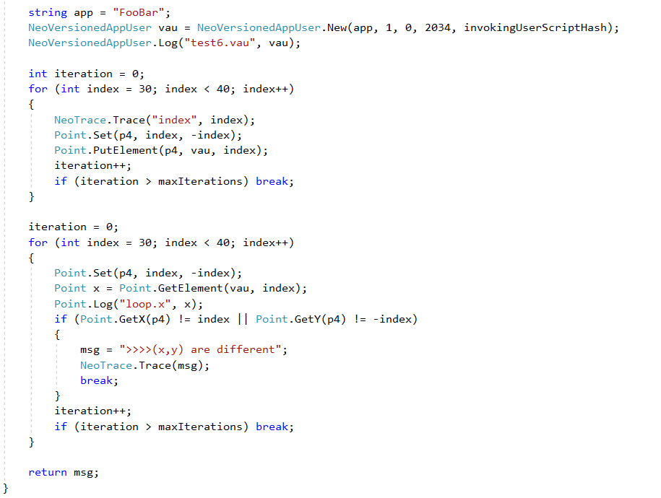
Test6() – Code (con’t)

Slide 56
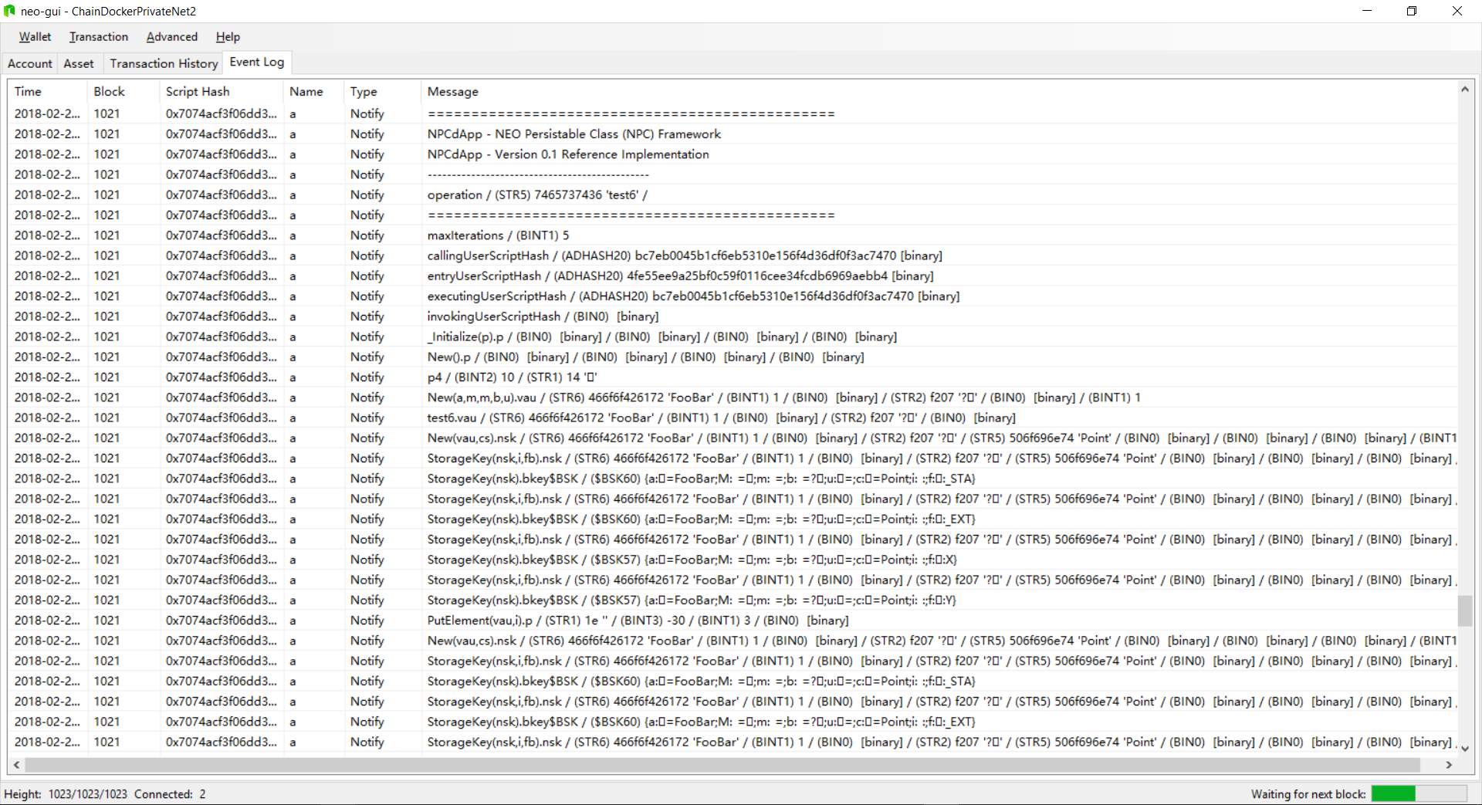
Test6() – neo-gui Event Log

Slide 57
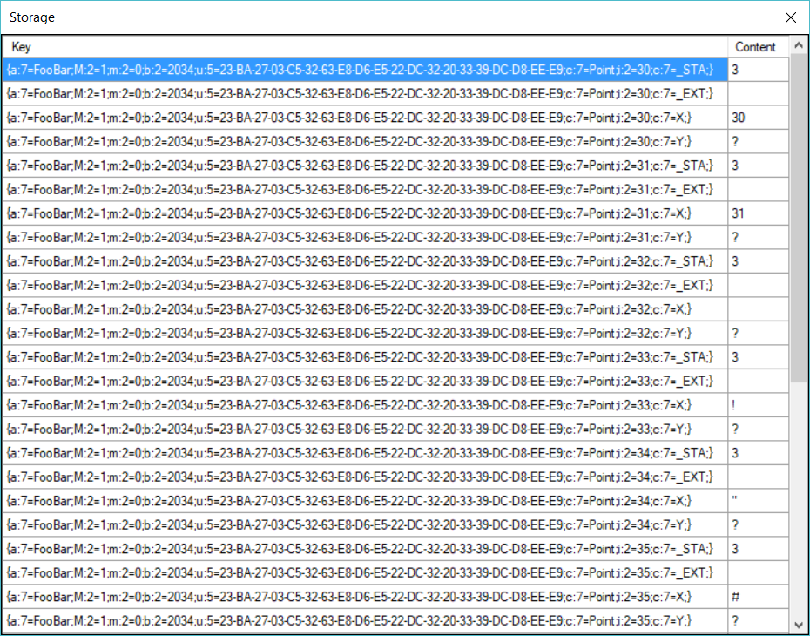
Test6() Results – neo-debugger Storage Viewer

Slide 58
8. Future Work

Slide 59
9. Summary

Slide 60
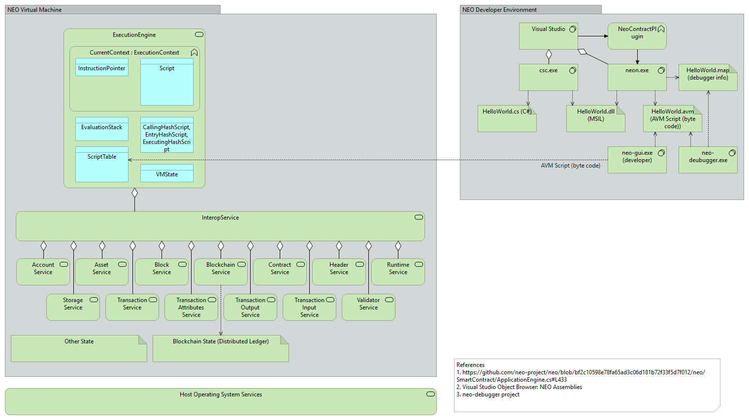
A - NEO Blockchain Architecture Reference Model (ARM)

Slide 61
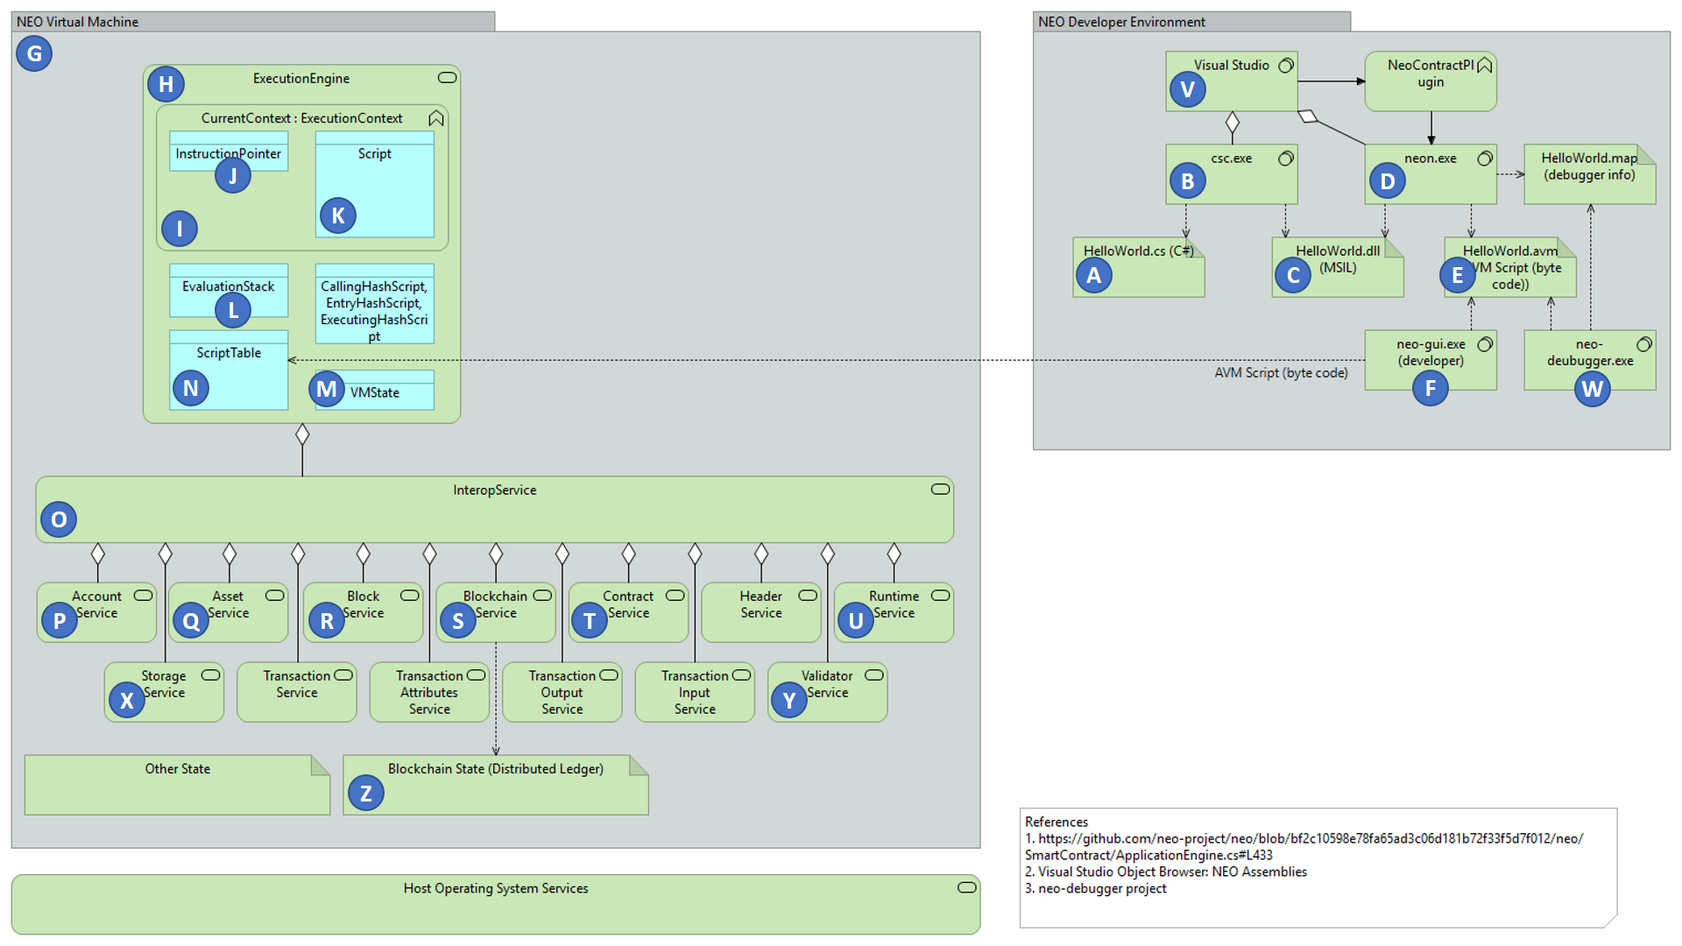
NEO Blockchain ARM

Slide 62
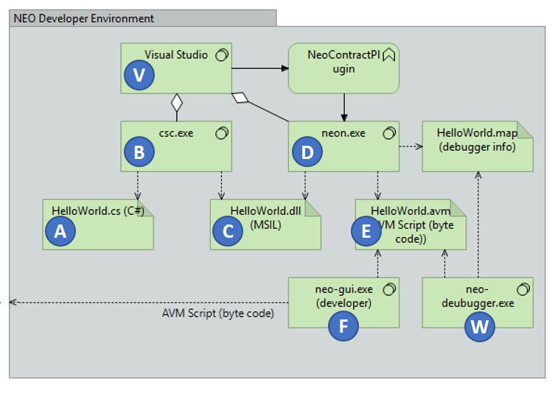
NEO Developer Environment

Slide 63
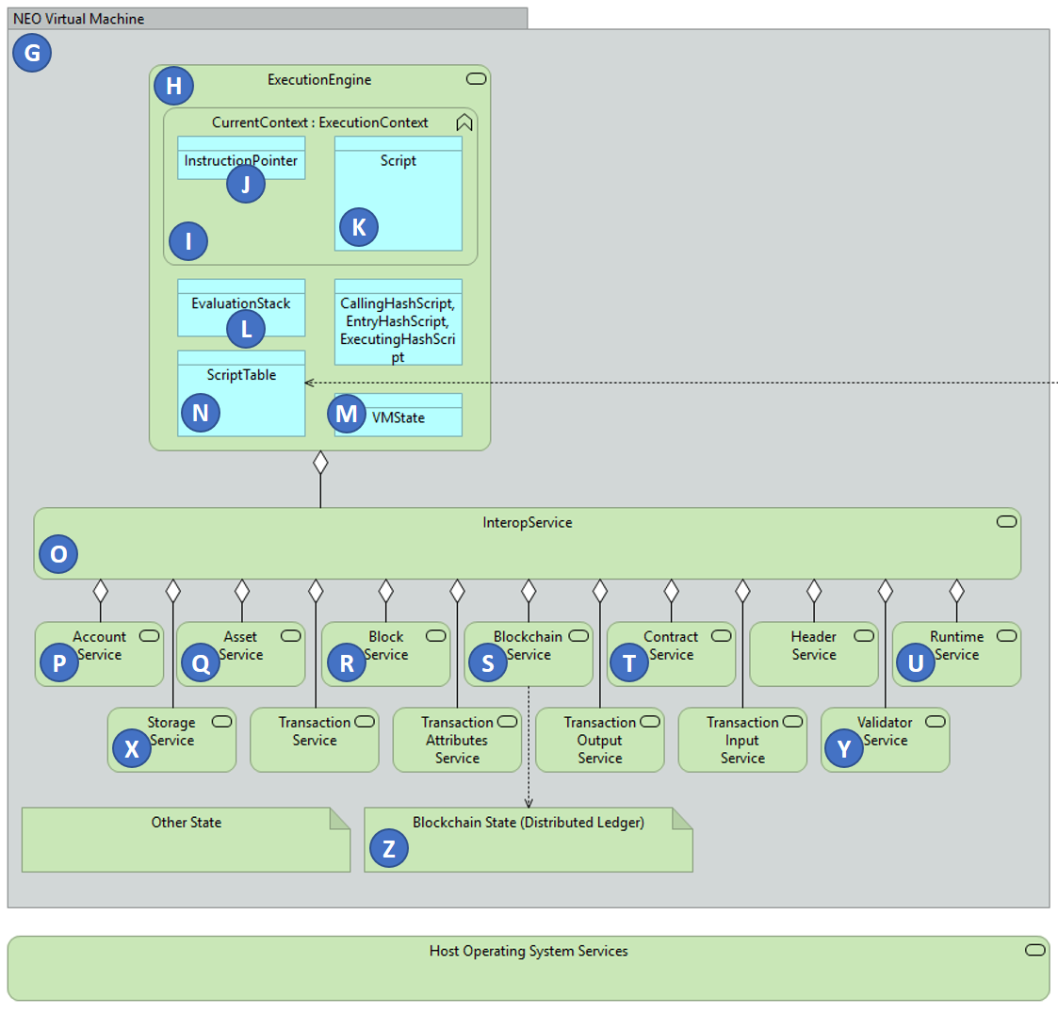
NEO Virtual Machine

Slide 64
Questions?
neotoronto@outlook.com

